Slide 1

Using Executable SysML Models to Generate Systems Engineering Products
May 22, 2016, Robert Karban
Jet Propulsion Laboratory,
California Institute of Technology
© 2016 California Institute of Technology. Government sponsorship acknowledged.

Slide 2
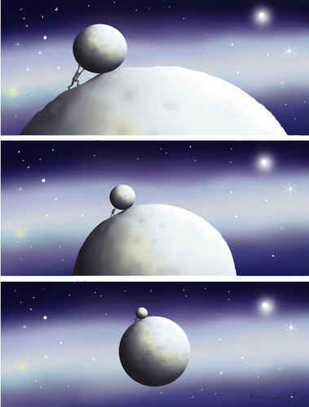
Outline
System Analysis, MBSE
Executable Models
Running Example: TMT
ESEM
OpenMBEE
Summary
CST
CST
CST
MBSE
by marian kamensky

Slide 3
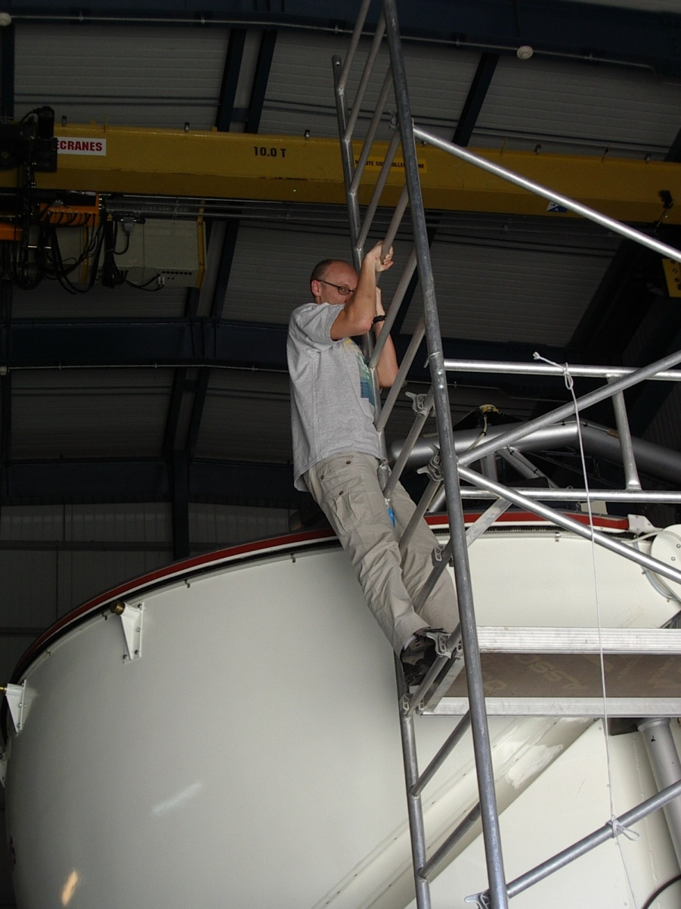
Who is Robert?
Master in Computer Science (Austria)
Senior Systems Architect at NASA’s JPL - USA
MBSE, CAE, TMT, Europa
Member of INCOSE
Member of the OMG SysML Revision Task Force
Formerly Control System/Software Engineer and Architect at:
Siemens Healthcare - Austria
Alcatel - France
CERN (LHC, LINAC, PS) – Switzerland/France
NRAO - USA
European Southern Observatory (VLT, ALMA, ELT) – Germany, Chile
User of MagicDraw/SysML since 2007

Slide 4
Systems Analysis
Carry out quantitative assessments of systems in order to select and/or update the most efficient system architecture and to generate derived engineering data.
System analysis provides a rigorous approach to technical decision-making. It is used to perform trade-off studies, and includes modeling and simulation, cost analysis, technical risks analysis, and effectiveness analysis.

Slide 5
Requirements Verification
A kind of systems analysis that assesses whether a system design meets the objectives and satisfies the constraints that are implied by the system requirements

Slide 6
Model Based Systems Engineering
MBSE is the formalized application of modeling techniques to support system requirements, design, analysis, verification, validation and documentation activities
MBSE expresses a system using a Systems Modeling Language (SysML), a profile of UML
MBSE is often applied with a method like Object Oriented System Engineering Method (OOSEM)

Slide 7
Project Question
How to perform requirements verification on systems models using vanilla SysML?

Slide 8
Proposed Approach
An extension of OOSEM named Executable Systems Engineering Method (ESEM)
ESEM produces executable SysML models that verify requirements
ESEM provides a set of analysis patterns that are specified with various SysML structural, behavioral and parametric diagrams

Slide 9
Executable Models
Most SysML models today are created for documentation purposes
The focus is on syntax and notation
Some SysML models are created to gain system understanding, explore and validate desirable or undesirable behaviors of a system
The focus is on semantics

Slide 10
Model Execution
Executable SysML models are defined with a subset of the language with well defined execution semantics
The subset is called Foundational UML (fUML)
SysML inherits the fUML subset from UML
SysML models are executed with the help of an execution, or simulation engine
Ex.: NoMagic’s Cameo Simulation Toolkit (CST)

Slide 11
Cameo Simulation Toolkit (CST)
A plugin to MagicDraw SysML modeling tool
A simulation platform based on fUML and plugs in additional execution engines
State Chart XML (SCXML)
Scripting for the Java Platform (JSR 223)
Precise Semantics of Composite Structures (PSCS)

Slide 12
Object Oriented System Engineering Method
Defines the architecture in terms of:
Domain: the context of the solution
Enterprise: the ecosystem of the solution
System of Interest: the solution being specified
Black Box: externally visible specification
Conceptual: white box functional specification
Physical: white box realization specification

Slide 13
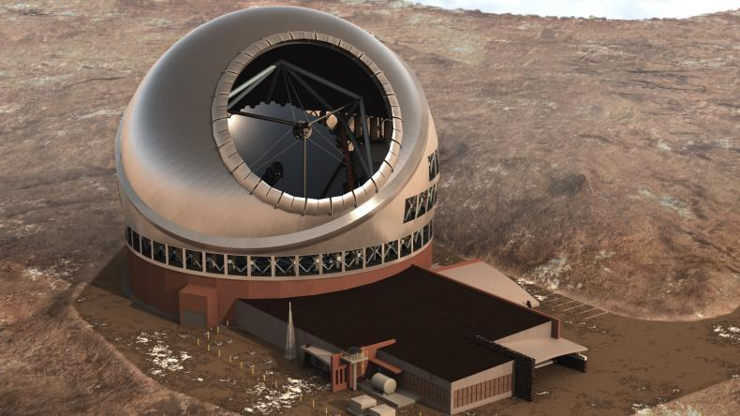
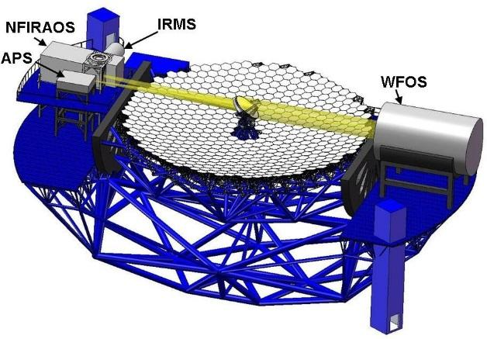
Running Example
Thirty Meter Telescope (TMT) http://www.tmt.org/
Alignment and Phasing System (APS)
Sensor responsible for pre-adaptive optics wavefront quality
Developed by TMT International Observatory (TIO)
JPL participates in several subsystems of TMT
JPL delivers the APS based on requirements from TIO
APS team uses MBSE to analyze requirements, produce design, and performs analysis

Slide 14
Running Example Objectives
Use MBSE to define executable SysML model that captures requirements, operational scenarios (use cases), system decomposition, relationships and between subsystems, etc.
Use the model to analyze the system design for
power consumption, mass and duration
Produce documents like
Requirement Flow Down Document
Operational Scenario Document
Design Description Document
Interface Control Documents
Goals: use standard languages and techniques, avoid custom software development

Slide 15
Motivation, Goals, Problems to solve
Capture operational use cases with estimated durations of actions
Post-segment exchange alignment
Maintenance Alignment
Capture power consumption properties
Identify involved subsystems, e.g. TCS, M1CS
Identify interfaces and interactions among subsystems
Analyze associated scenarios
Ensure timing and power consumpation requirements are met
Derive requirements for TMT subsystems
Develop/refine timing requirements for algorithms, internal and external interface commands

Slide 16
Approach
Capture relevant information in a SysML model (system database) using ESEM (Executable Systems Engineering Method)
Used SysML constructs
Block diagrams, State Machines, Activity Diagrams, Sequence diagrams
Simulate system level scenarios
Verify correctness by
Recording traces of simulation in sequence diagrams
Ensure all “leaf” actions have durations constraints applied
Ensure that all actions have been reached in the different scenarios
Automatically verify timing against formal constraints (requirements)

Slide 17
TMT Model
Customer and supplier model in same SysML project, APS and Adaptive Optics
Project level (customer) conceptual elements re-used for simulation in downstream design
Analysis: Duration, Power and Mass
https://github.com/Open-MBEE/TMT-SysML-Model

Slide 18
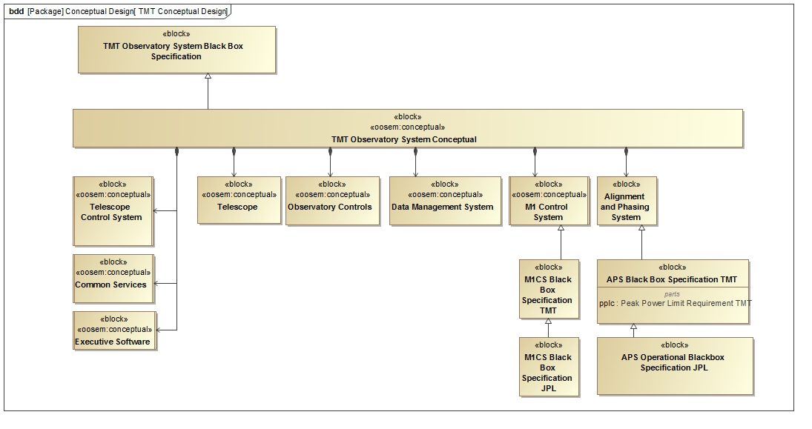
Observatory Conceptual Model

Slide 19
Executable System Engineering Method (ESEM)
Step 1: Formalize Requirements
Step 2: Specify Design
Step 3: Characterize Components
Step 4: Specify Analysis Context
Step 5: Specify Operational Scenarios
Step 6: Specify Analysis Configurations
Step 7: Run Analysis

Slide 20
Step 1: Formalize Requirements
Requirement Pattern
Customer Side
Define the textual requirement with a Requirement
Optionally define a design black box specification with a Block with relevant value properties
Optionally refine the Requirement with a Constraint Block on the black box design Block
Supplier Side
Define a design black box specification with a Block (that refines the customer’s black box Block if any and provides tighter property values)
Refine the textual Requirement by a Constraint Block (if not already defined by the customer)

Slide 21
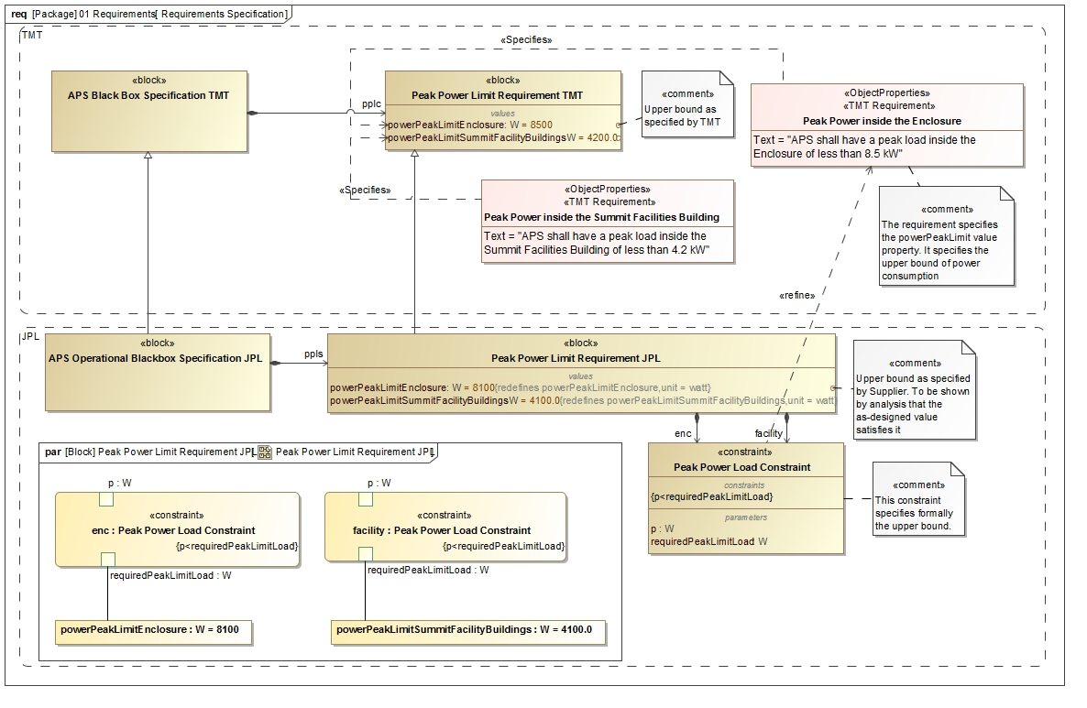
Step 1: Formalize Requirements

Slide 22
Step 2: Specify Design
Follow OOSEM to define two white box specifications that specialize the black box specification
Conceptual Specficiation
Realization Specification
Decompose the white box designs into Blocks representing the subsystems

Slide 23
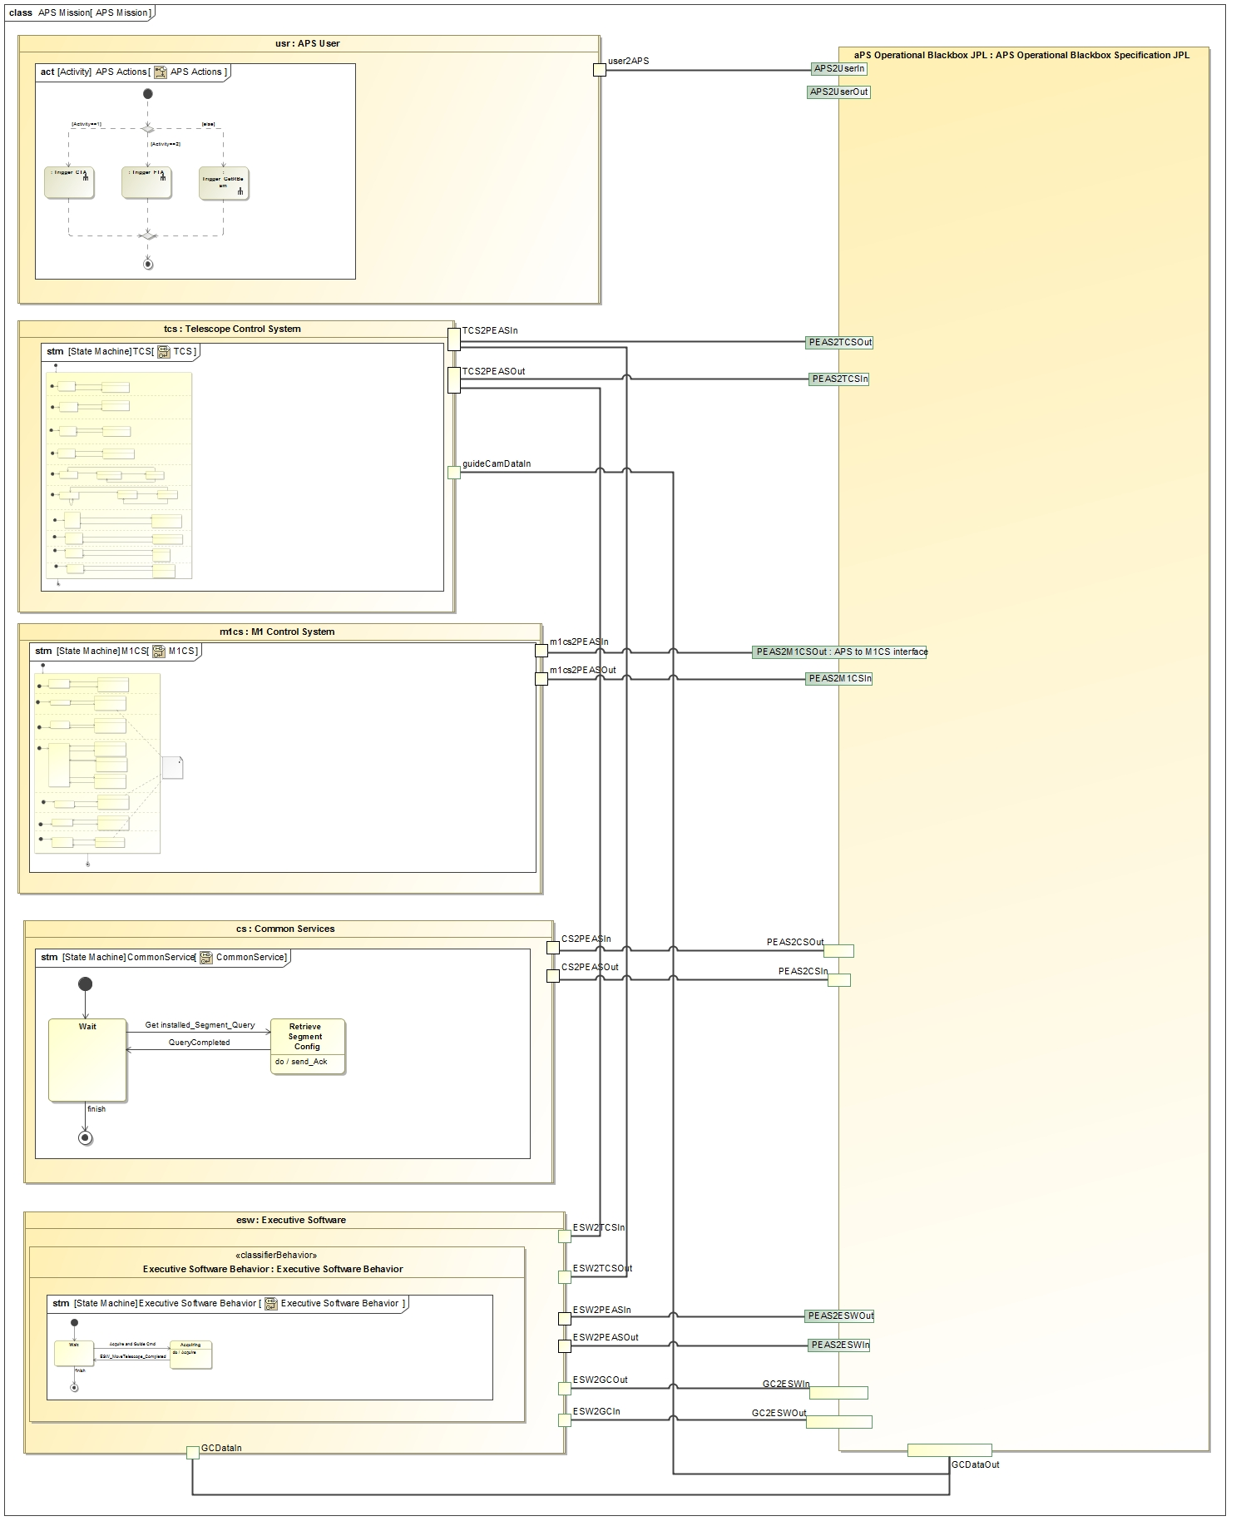
Step 2: Black Box Level
Project level components communicate with APS black box block

Slide 24
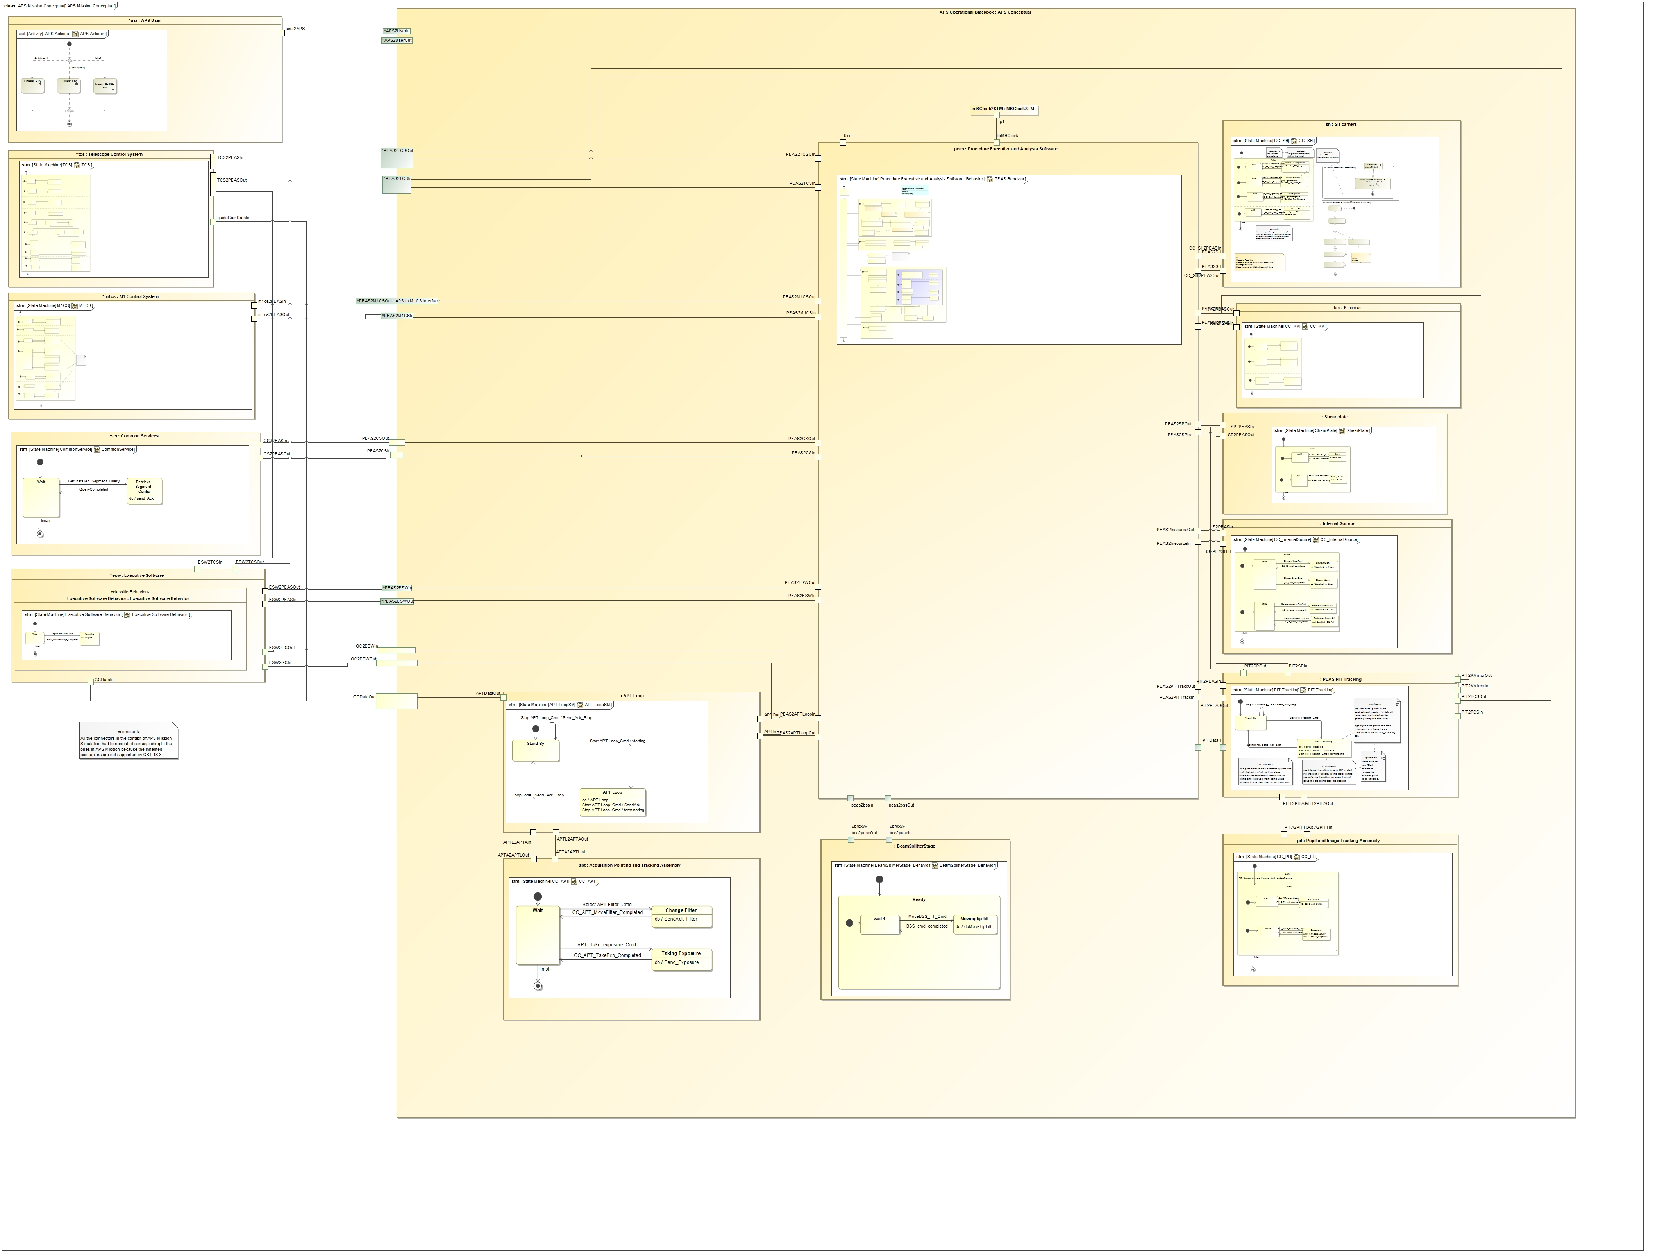
Step 2: Conceptual Model
Communication between state machine specified components over ports

Slide 25
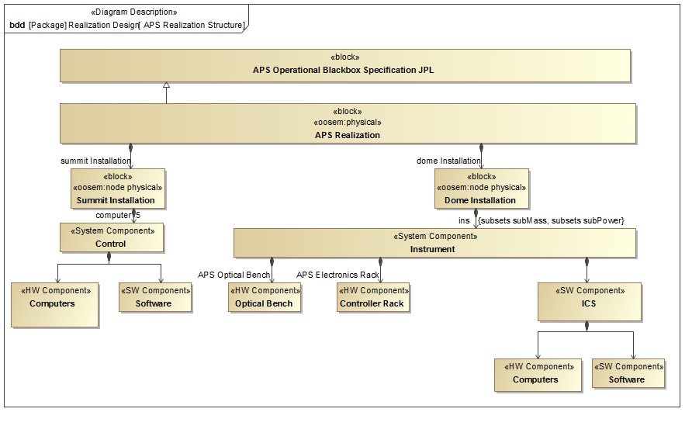
Step 2: Realization
System Decomposition Hierarchy

Slide 26
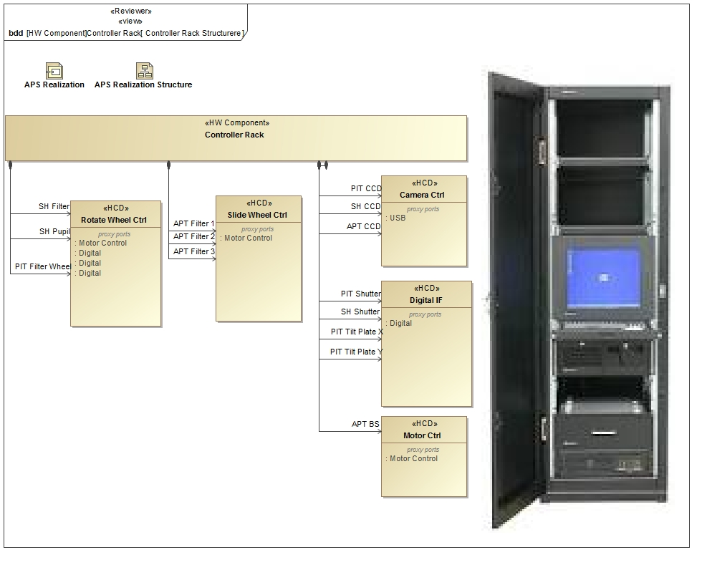
Step 2: Realization
System Decomposition Hierarchy

Slide 27
Step 3: Characterize Components
Add relevant patterns to the design Block to make it executable
Example: Roll-up Pattern
Constrained value represents an aggregate value that is propagating up a hierarchy of subcomponents
Static roll-up (e.g., mass roll-up)
Dynamic roll-up (e.g., power roll-up)

Slide 28
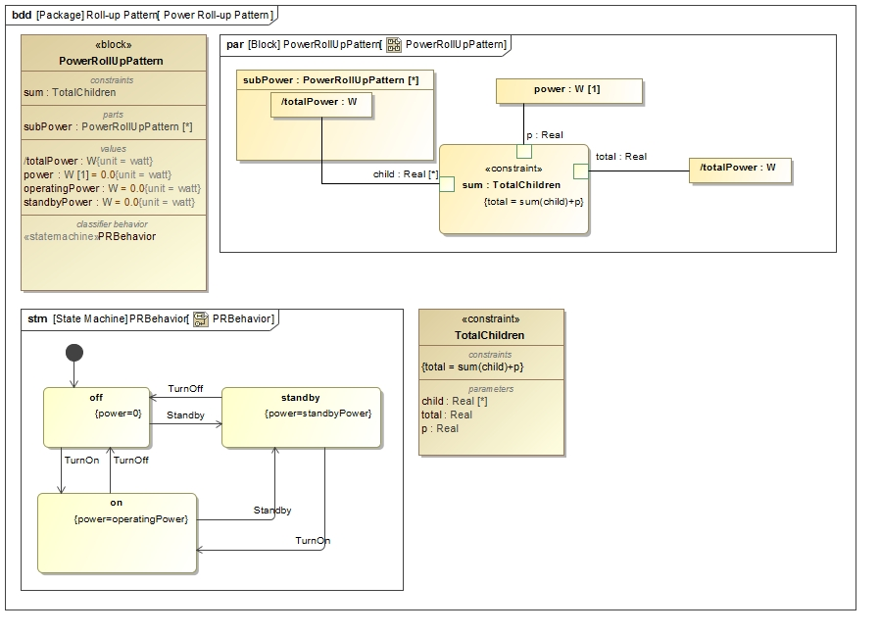
Step 3: Characterize Components
State constraints
Power Rollup Pattern

Slide 29
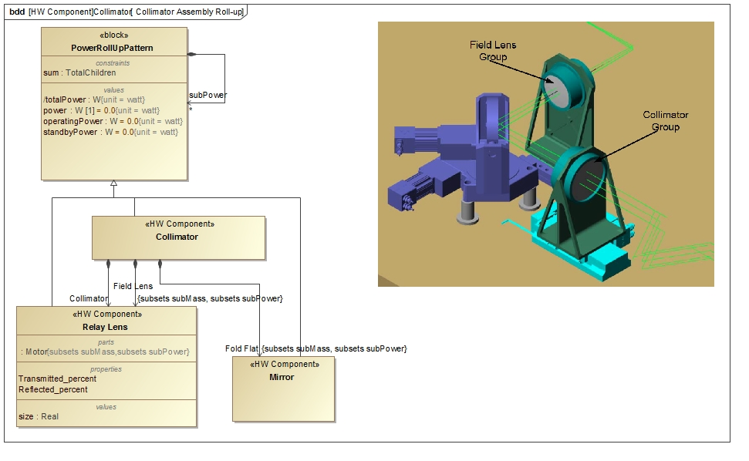
Step 3: Characterize Components
Power Roll-up Pattern Application

Slide 30
Step 4: Specify Analysis Context
Analysis Context Pattern
Abstract analysis context Block composes both the design black box Block and white box Block
Analysis properties defined on the analysis context Block (e.g., peak power, power margin)
Analysis parametric model on the analysis context that computes and binds analysis values

Slide 31
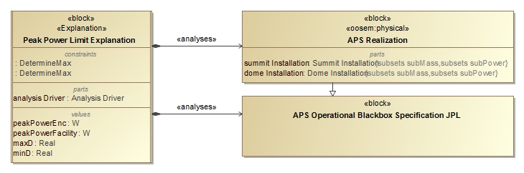
Step 4: Specify Analysis Context
Analysis Context Pattern

Slide 32
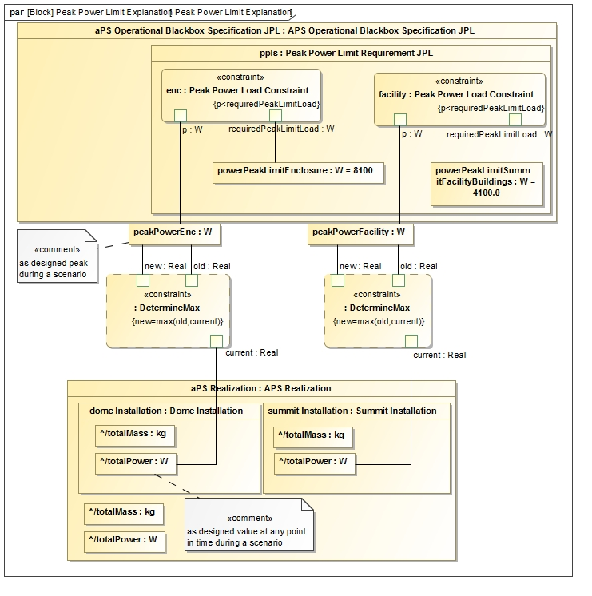
Step 4: Specify Analysis Context
Analysis Context Parametric Model

Slide 33
Step 5: Specify Operational Scenarios
Operational Scenario Pattern
Concrete analysis context Block that
Represents one operational scenario (e.g., power configuration)
Specializes the abstract analysis context Block
Redefines context’s properties with scenario-specific values
Defines an owned behavior (sequence diagram) as scenario driver
Changes the states of the different components, by sending them signals, causing the rolling-up to occur automatically
Can specify duration constraints to time the injection of signals thus controlling time spent in a certain state
Can use state constraints (on components) to verify during execution if a component is actually in expected state

Slide 34
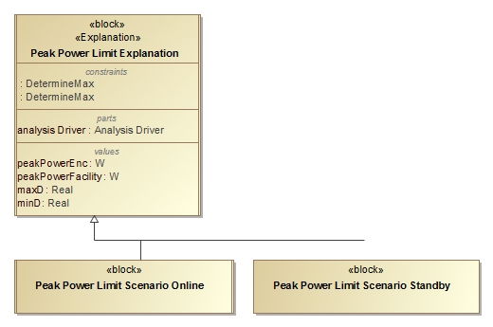
Step 5: Specify Operational Scenarios
Operational Scenario Pattern

Slide 35
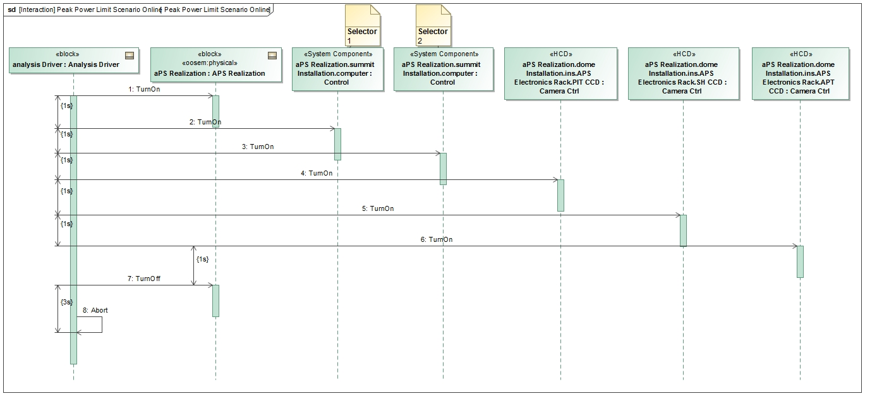
Step 5: Specify Operational Scenarios
Operational Scenario Driver

Slide 36
Step 6: Specify Scenario Configurations
Scenario Condition Pattern
A decomposition tree of instance specifications representing the state of the scenario
Can be presented in tabular form
Rows represent the instance specifications (e.g., component)
Columns represent values (e.g., operating power) from the instance specifications
Issues
Hard to keep instance specifications in sync with Block hierarchy
Mitigation: tool automation
Instance specifications cannot be displayed in IBDs
Mitigation: use full specialization tree of singleton Blocks for each scenario

Slide 37
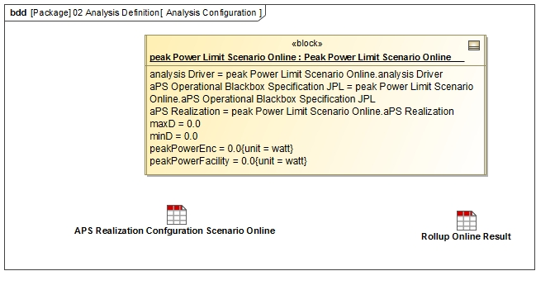
Step 6: Specify Analysis Configurations
Scenario Configuration Pattern

Slide 38
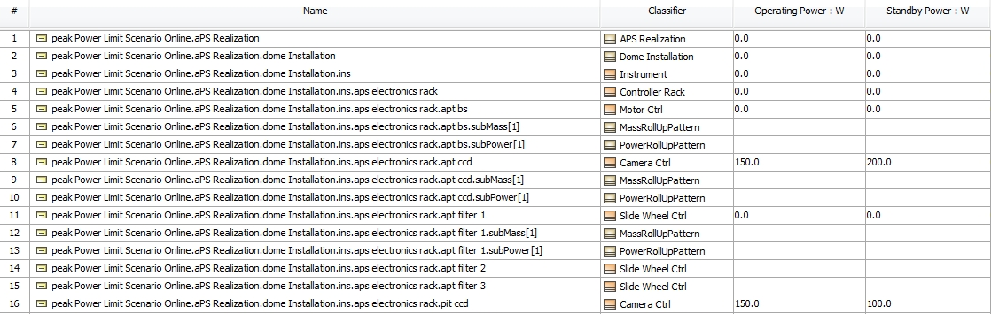
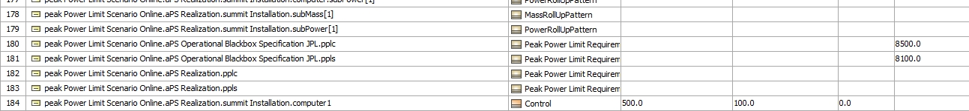
Step 6: Specify Analysis Configurations
Scenario Initial Condition Pattern

Slide 39
Step 6: Specify Scenario Configurations
Scenario Configuration Pattern
Scenario configuration is an Instance Specification of the scenario’s concrete analysis Block
References an initial scenario condition with an <<analyzes>> relationship
References a final scenario condition with an <<explains>> relationship

Slide 40
Step 7: Run Analysis
Run the configured analysis with a simulation engine on the initial conditions to get the final conditions:
Produce the following views on final conditions
Table showing final analysis values (e.g., peak power) and the constraint’s pass/fail status for each scenario
Timelines: state changes for components over time
Value profiles: total rolled up values over time

Slide 41
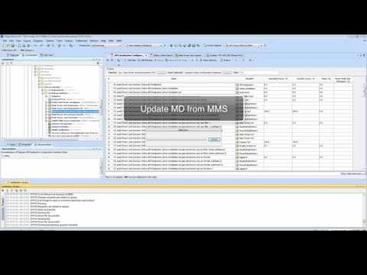
Step 7: Run Analysis

Slide 42
OpenMBEE
Provides a platform for modeling that serves SysML CAE Client and Web-based View Interaction – integrates JPL’s mission environment openCAE
Basic Infrastructure for Version, Workflow, Access Control
Flexibility of content
Support for Web Applications and Web-based API access
https://github.com/Open-MBEE

Slide 43
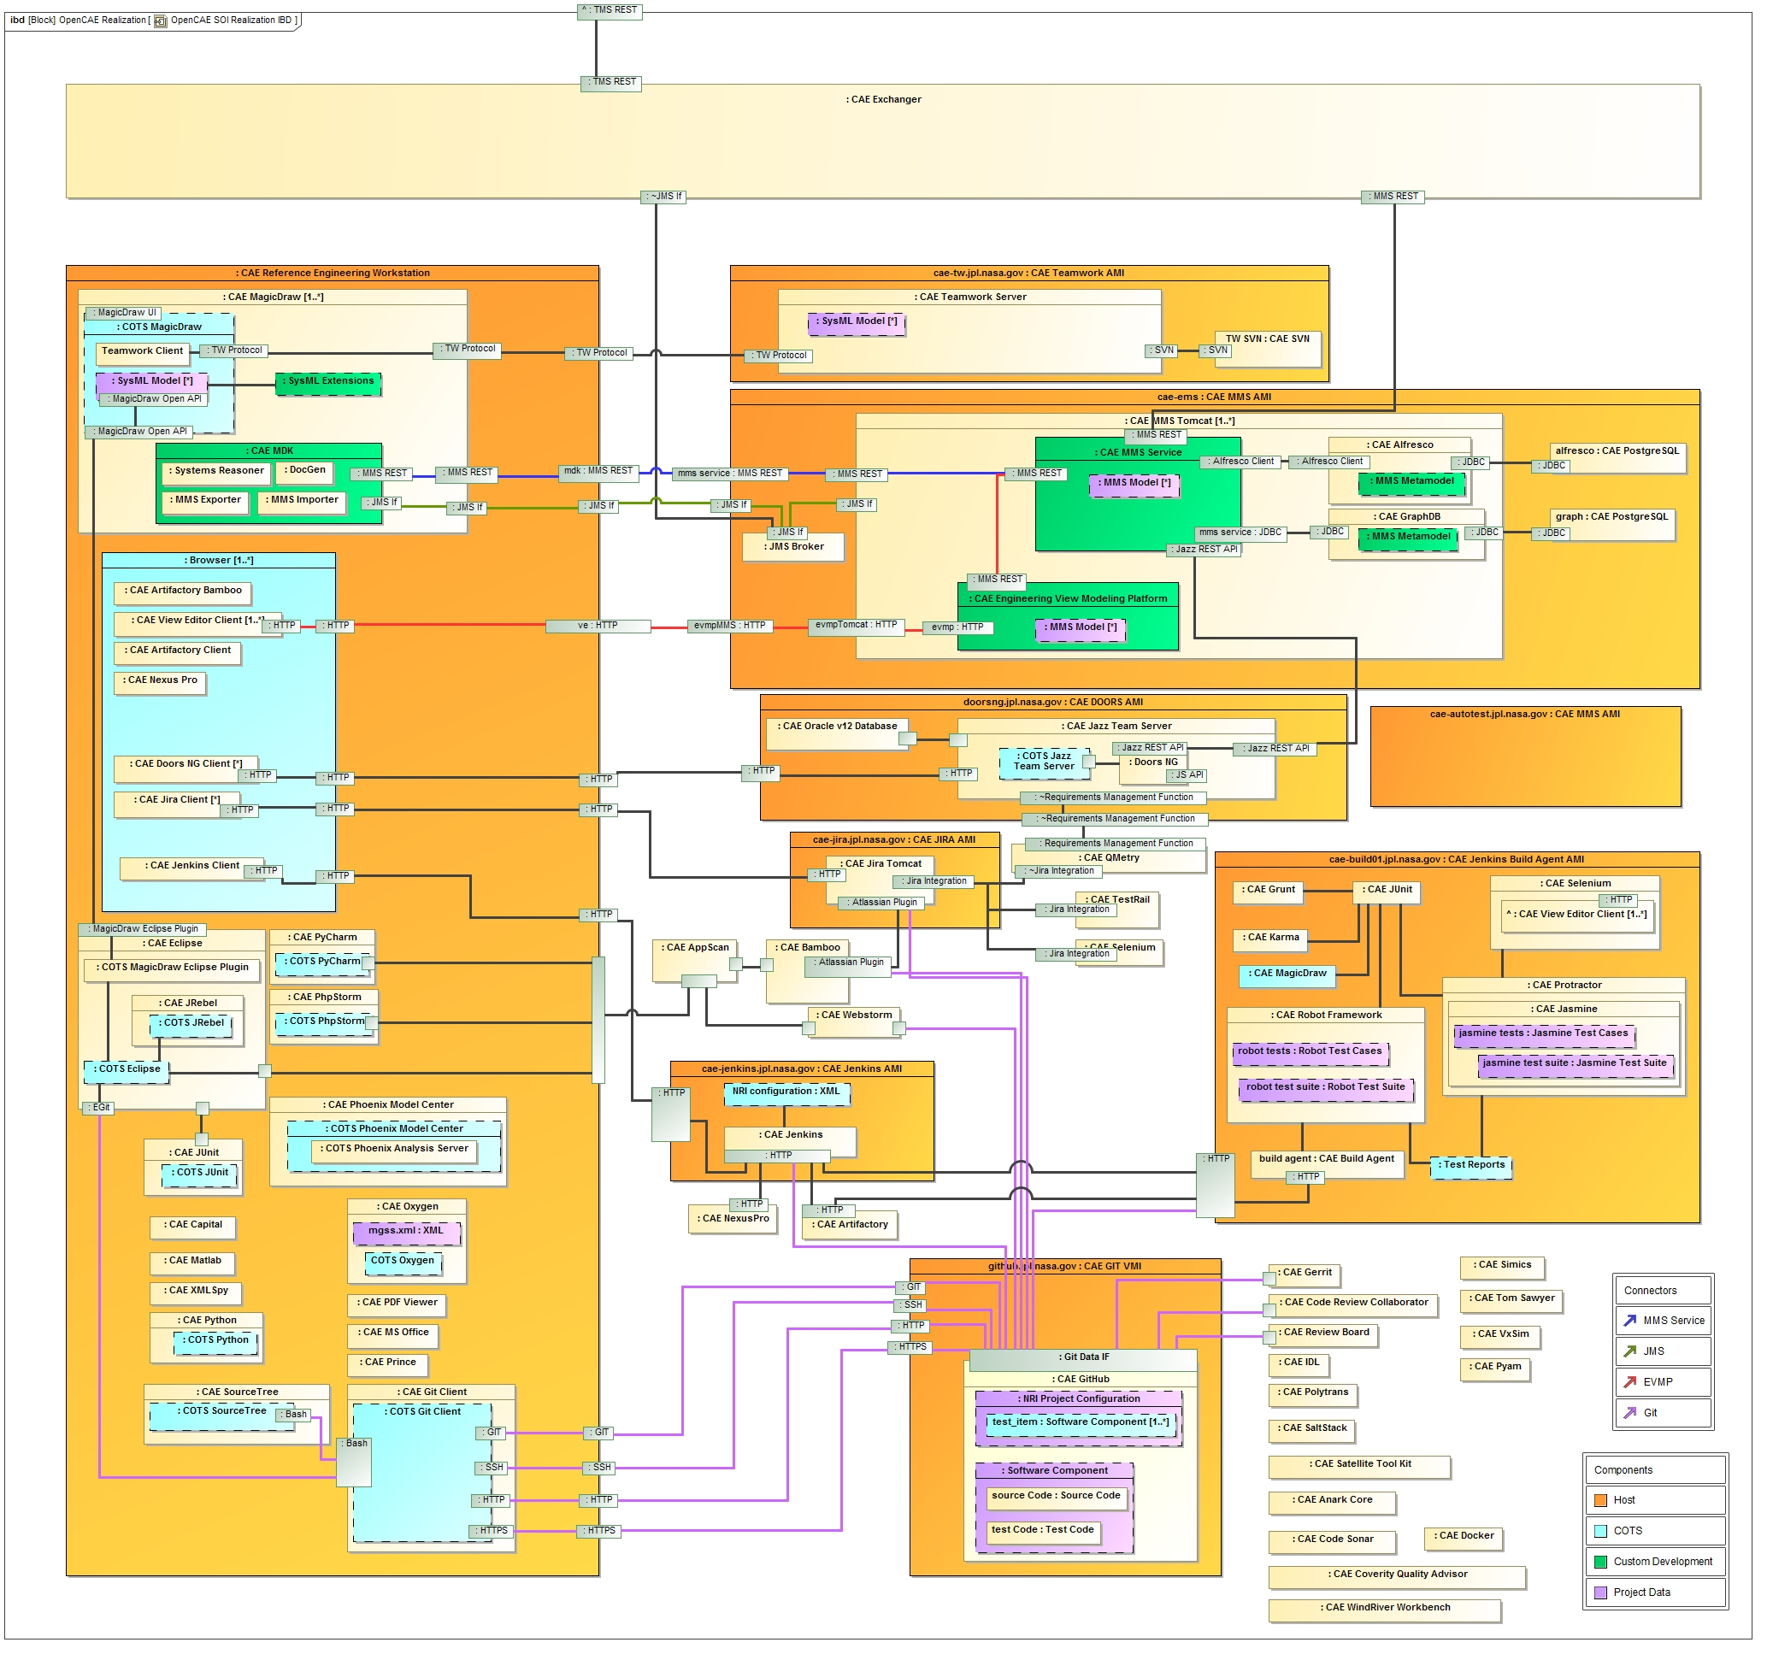
OpenMBEE Current Realization

Slide 44
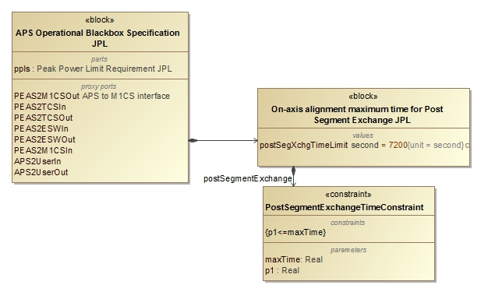
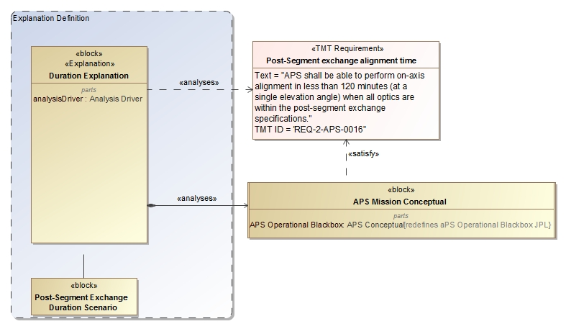
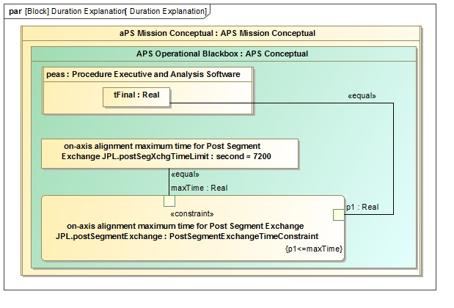
Duration Analysis
Specify Property Based Requirement
Analyze Conceptual Design

Slide 45
Step 2: Conceptual Model
Communication between state machine specified components over ports

Slide 46
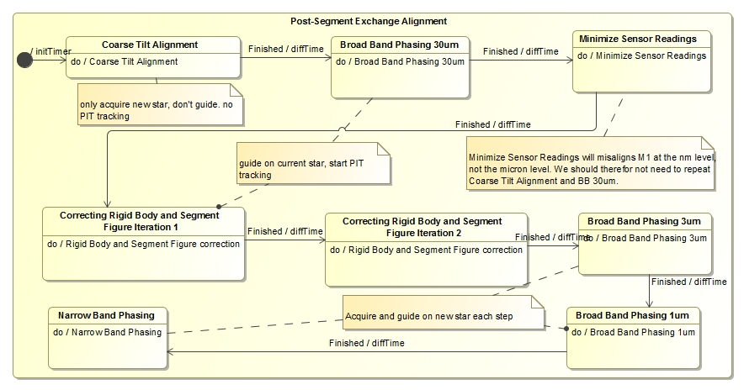
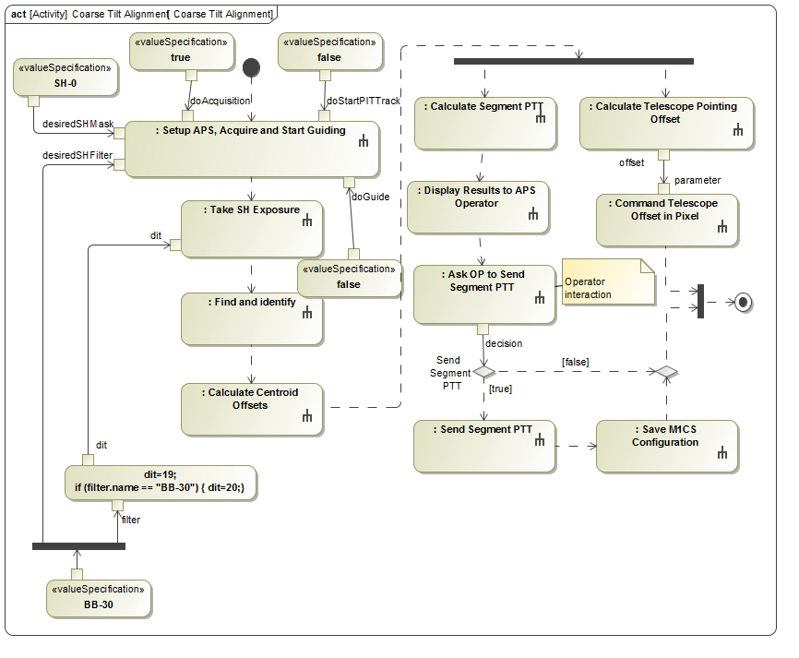
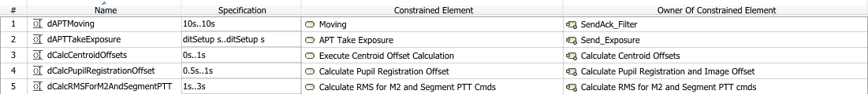
Conceptual Design
Operational behavior captured with
state machines and activity models

Slide 47
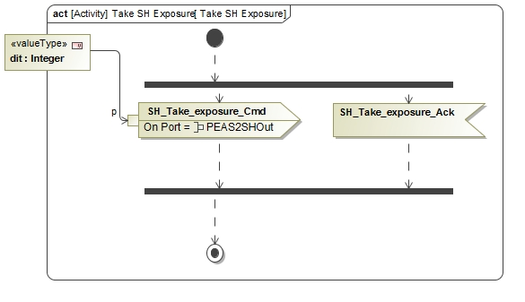
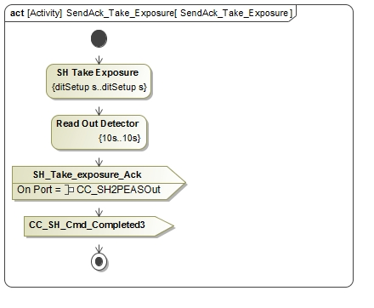
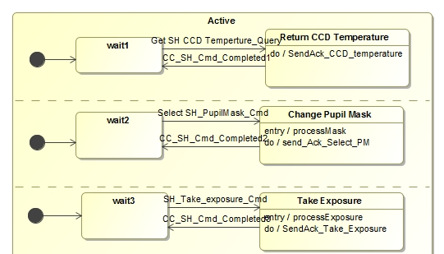
Conceptual behavior model
Dynamic and fixed duration constraints
Communicating
state machines
Duration analysis results verified against requirement for a particular configuration

Slide 48
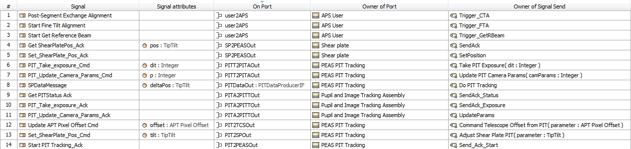
Interchanges between conceptual components
Provides information for ICD from conceptual behavioral model

Slide 49
Summary & Outlook
It is possible to automate requirements verification in SysML models
Introduced a new Executable System Engineering Method that consists of a set of pure SysML analysis patterns
The method can be executed using an over Off the shelf simulation engine for SysML
Trigger Analysis from Web interface and auto-generate documents
Viewpoints which provide the power profile plots in View Editor
Store results in time line database

Slide 50
Reference
Karban, R., Jankevičius, N., Elaasar, M. “ESEM: Automated Systems Analysis using Executable SysML Modeling Patterns”, (to appear in the proceedings of INCOSE International Symposium (IS), Edinburgh, Scotland, 2016.)
Karban, R., Jankevičius, N., Elaasar, M. “Creating System Engineering Products with Executable Models in a Model Based Engineering Environment.” (to appear in proceedings of Modeling, Systems Engineering, and Project Management for Astronomy VI , Edinburgh, UK, 2016)

